Slide 1
Topic 6 CLOSED SYSTEMS
Thermodynamics: An Engineering Approach
8th Edition Yunus A. Çengel, Michael A. Boles
McGraw-Hill, 2015

Slide 2
Objectives
Examine the moving boundary work or P dV work commonly encountered in reciprocating devices such as automotive engines and compressors.
Identify the first law of thermodynamics as simply a statement of the conservation of energy principle for closed (fixed mass) systems.
Develop the general energy balance applied to closed systems.

Slide 3
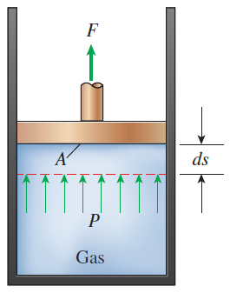
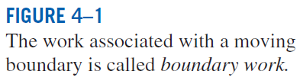
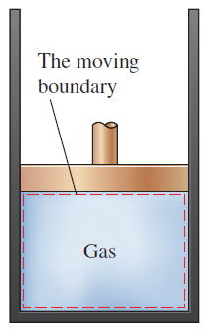
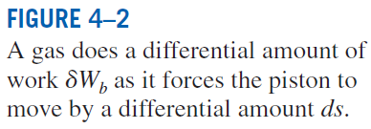
MOVING BOUNDARY WORK
Moving boundary work (P dV work): The expansion and compression work in a piston-cylinder device.
Quasi-equilibrium process: A process during which the system remains nearly in equilibrium at all times.
W_{b} is positive → for expansion
W_{b} is negative → for compression

Slide 4
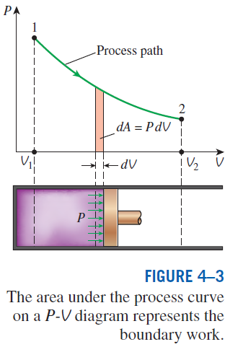
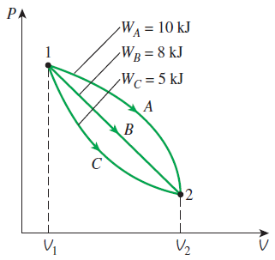
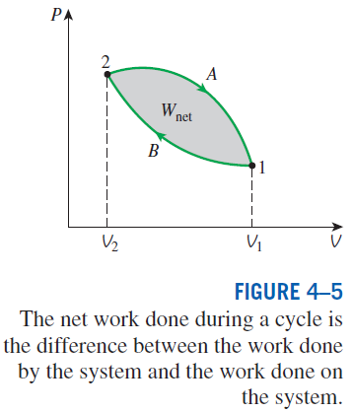
The boundary work done during a process depends on the path followed as well as the end states.
The area under the process curve on a P-V diagram is equal, in magnitude, to the work done during a quasi-equilibrium expansion or compression process of a closed system.

Slide 5
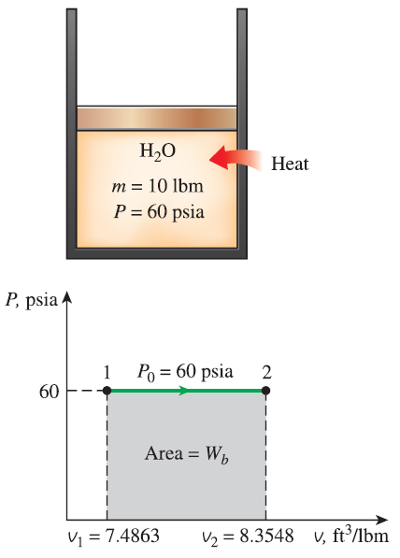


Boundary Work for a Constant-Pressure Process

Slide 6
Boundary Work for a Constant-Pressure Process
A piston cylinder device contains 10 lbm of steam at 60 psia and 320ºF. Heat is now transferred to the steam until the temperature reaches 400ºF. Assuming the mass of the piston and the atmospheric pressure remain constant, determine the work done by the steam during the heating process.
Solution 1

Slide 7
Isothermal compression of an Ideal Gas
A piston cylinder device initially contains 0.4 m³ of air at 100 kPa and 80ºC. The air is then compressed to 0.1 m³ in such a way that the temperature of the air remains constant. Determine the work done during the process.
Solution 2

Slide 8
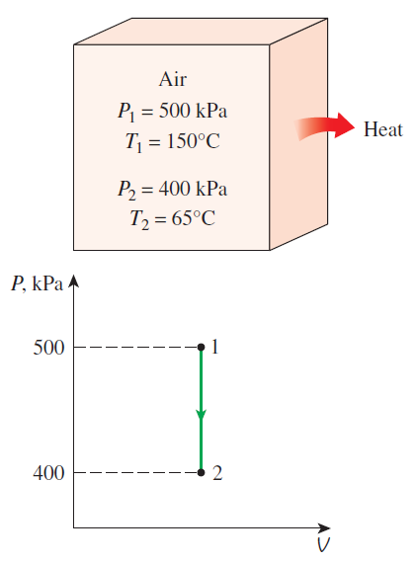
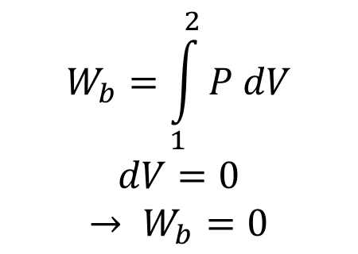
Boundary Work for a Constant-Volume Process
What is the boundary work for a constant-volume process?
$$W_{b}=\int_{1}^{2}{P dV}$$
$$dV=0$$
$$→ W_{b}=0$$
Boundary work done during a constant volume process is always zero.

Slide 9
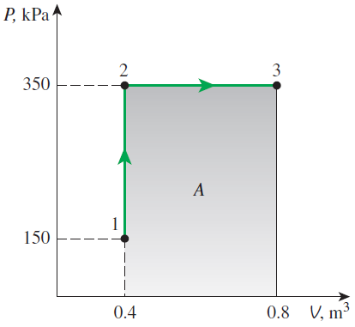
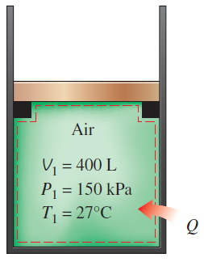
Heating of a Gas at Constant Pressure
A piston cylinder device initially contains air at 150 kPa and 27ºC. Initially, the piston is resting on stops (as shown below) and the enclosed volume is 400 L. The piston requires at least 350 kPa to move it. The air is then heated until the volume doubled. Determine the final temperature, the work done by the system, and the total heat transferred to the air.
Solution 3

Slide 10
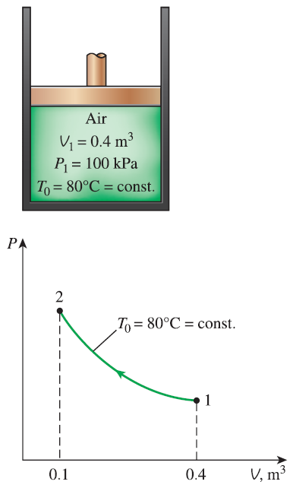



Boundary Work for an Isothermal Compression Process

Slide 11

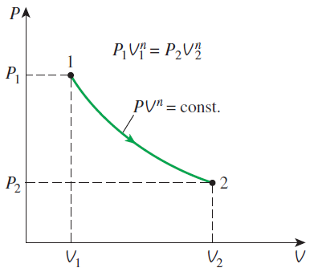
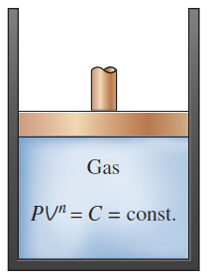
Boundary Work for a Polytropic Process
For ideal gas

Slide 12
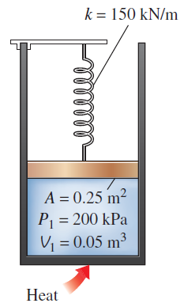
Expansion of gas against a spring
A piston cylinder device contains 0.05 m³ of a gas initially at 200 kPa. At this initial state, the linear spring has a spring constant of 150 kN/m but is exerting no force on it. Heat is then transferred to the system causing the volume to double in size. As a result of the expansion, the piston rises and the spring is compressed. The cross sectional area of the piston is 0.25 m². Determine the final pressure of the gas inside the cylinder and the work done by the gas.
Solution 4

Slide 13
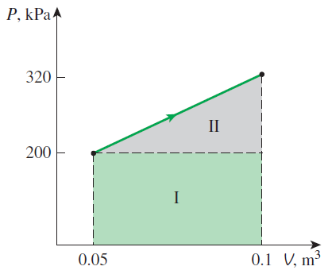
Expansion of a Gas against a Spring
Notes:
Figure 4-10 for Example 4-4

Slide 14
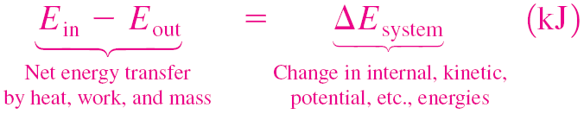
ENERGY BALANCE FOR CLOSED SYSTEMS
Energy balance for any system undergoing any process
Energy balance in the rate form
The total quantities are related to the quantities per unit time is
Energy balance per unit mass basis
Energy balance in differential form
Energy balance for a cycle

Slide 15

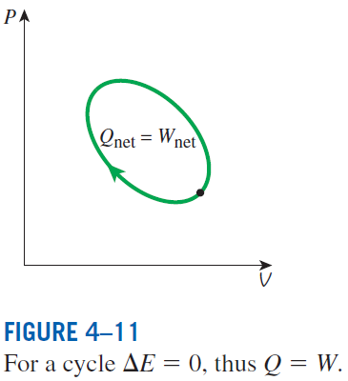
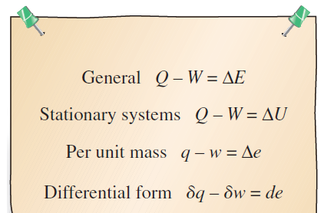
Energy balance when sign convention is used: (i.e., heat input and work output are positive; heat output and work input are negative).
Various forms of the first-law relation for closed systems when sign convention is used.
The first law cannot be proven mathematically, but no process in nature is known to have violated the first law, and this should be taken as sufficient proof.

Slide 16
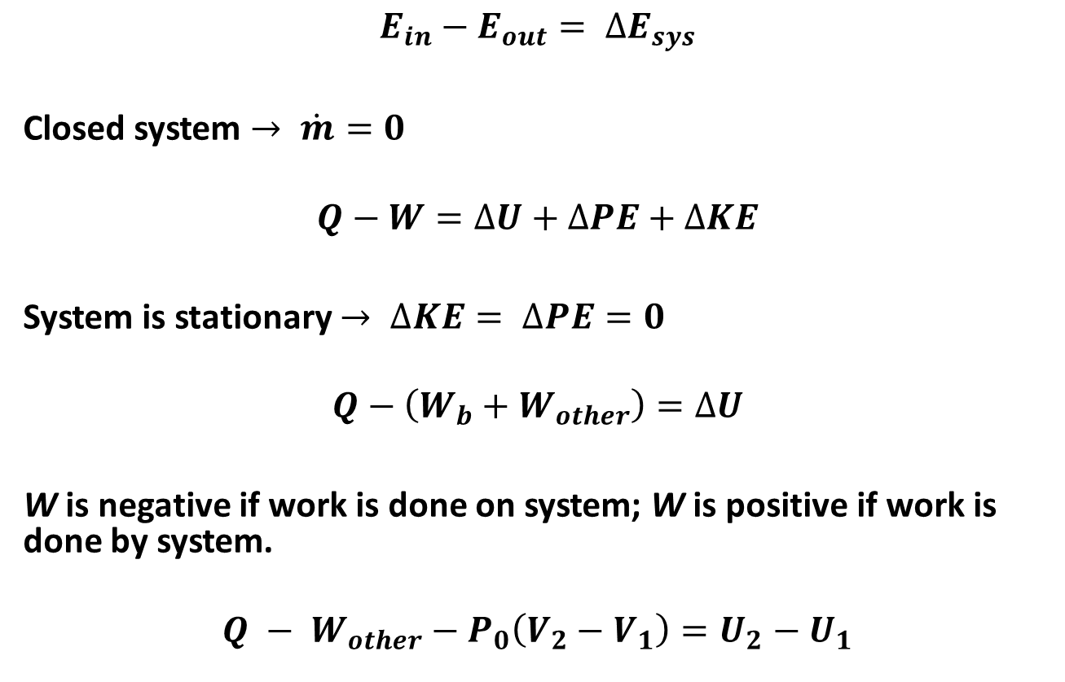
Energy Balance for Constant Pressure Process
$$E_{in}−E_{out}= ∆E_{sys}$$
Closed system $→ \dot{m}=0$
$$Q−W=∆U+∆PE+∆KE$$
System is stationary $→ ∆KE= ∆PE=0$
$$Q−\left(W_{b}+W_{other}\right)=∆U$$
W is negative if work is done on system; W is positive if work is done by system.
$$Q − W_{other}−P_{0}\left(V_{2}−V_{1}\right)=U_{2}−U_{1}$$

Slide 17
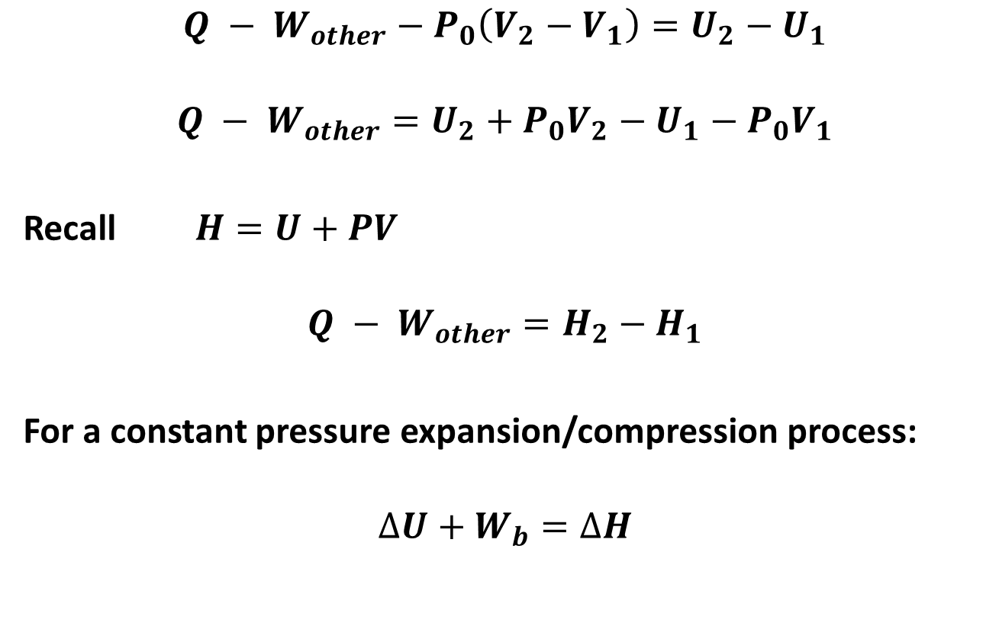
Energy Balance for Constant Pressure Process
$$Q − W_{other}−P_{0}\left(V_{2}−V_{1}\right)=U_{2}−U_{1}$$
$$Q − W_{other}=U_{2}+P_{0}V_{2}−U_{1}−P_{0}V_{1}$$
Recall $H=U+PV$
$$Q − W_{other}=H_{2}−H_{1}$$
For a constant pressure expansion/compression process:
$$∆U+W_{b}=∆H$$

Slide 18
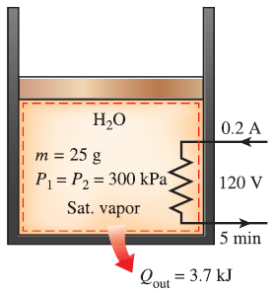
Example: Heating of a gas at constant pressure
A piston cylinder device contains 25 g of saturated water vapor that is maintained at a constant pressure of 300 kPa. A resistance heater running off of 0.2 A and 120 V is used to heat the vapor for 5 minutes. At the same time, the system experiences a heat loss of 3.7 kJ. Determine the final temperature.
Solution 5

Slide 19
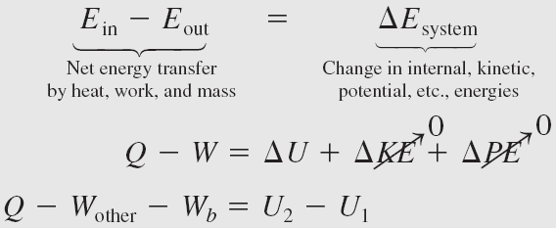
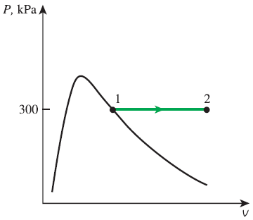
Energy balance for a constant-pressure expansion or compression process
General analysis for a closed system undergoing a quasi-equilibrium constant-pressure process. Q is to the system and W is from the system.
For a constant-pressure expansion or compression process:
An example of constant-pressure process
Notes:
Figure 4-13 for Example 4-5

Slide 20
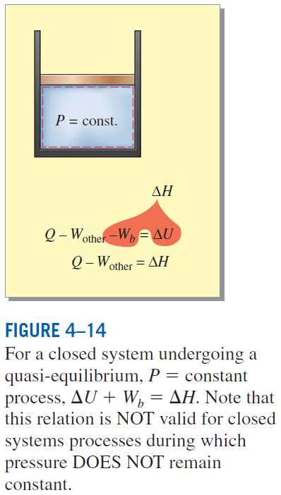
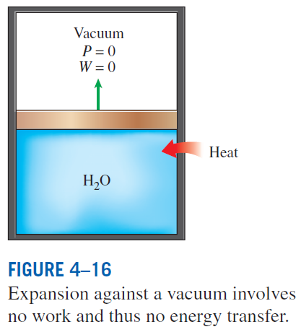

Slide 21
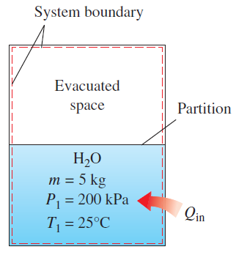
Unrestrained Expansion of Water
A rigid tank is divided into two equal parts by a partition. Initially, one side contains 5 kg of water at 200 kPa and 25ºC and the other side is evacuated (i.e. is a vacuum). Once the partition is removed, water expands into the evacuated space. During the expansion, the system is allowed to exchange heat with its surroundings to maintain its initial temperature of 25ºC. Determine the final pressure and the heat transfer for this process.
Solution 6

Slide 22
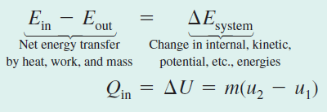
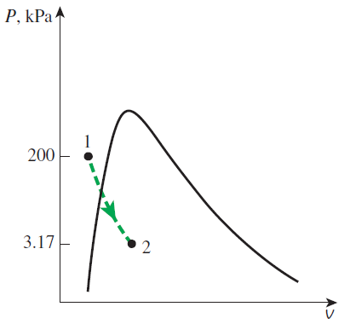
Unrestrained Expansion of Water
Notes:
Figure 4-15 for Example 4-6

Slide 23
Summary
Moving boundary work
W_{b} for an isothermal process
W_{b} for a constant-pressure process
W_{b} for a polytropic process
Energy balance for closed systems
Energy balance for a constant-pressure expansion or compression process

